Slide 1

Forecasting Covid-19 cases using SARS-Cov2 Titers in Wastewater
CS-109B: Group #111
Spring 2021
TEAM
Vivek Bhatia
Prakash Bhatt
Lalitanjali Bondili
Raghu Soori

Slide 2
CONTENTS
Introduction
Data Description
Data Pre-Processing
Exploratory Data Analysis
Models Explored
Model Validation
Conclusion & Next Steps

Slide 3
INTRODUCTION
Conventionally COVID-19 is tracked via symptomatically and clinically diagnosed cases. This method has inherent drawback as many of the patients do not report the disease.
Recent developments in detecting COVID-19 cases have led to techniques such as measuring viral titers in urban wastewater as a method to track and forecast COVID-19 cases.
Longitudinal wastewater analysis can be used to predict COVID-19 cases more accurately and more instantaneously than clinical data.

Slide 4
Project Proposal
We intend to explore and establish the relationship between wastewater surveillance data collected and maintained by the Massachusetts Water Resources Authority, and the outbreak of COVID-19 in the neighboring communities.
We used supervised learning techniques to develop models which can closely predict the current count of COVID-19 cases in the community using solely the data available from wastewater viral titers

Slide 5
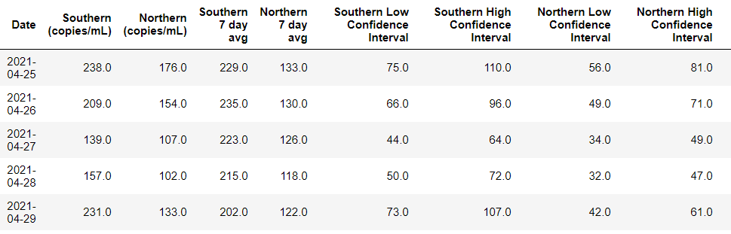
Data Description
MWRA Wastewater COVID-19 Tracking Data - Collected by Massachusetts Water Resources Authority measuring the quantity of COVID-19 viral RNA samples in sewage wastewater for Boston’s Southern and Northern districts
TAKE AWAY
Point 1
Point 2

Slide 6
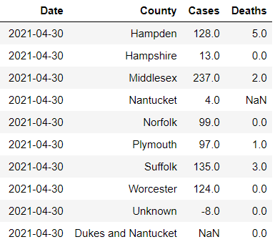
Data Description
Massachusetts official COVID-19 Case Count: Publicly available dataset provided by the Massachusetts Department of Public Health
TAKE AWAY
Point 1
Point 2

Slide 7
Data Pre-Processing
Write something about
df_covid.interpolate(method="akima", limit_direction='both', inplace=True)
Replace NaNs with 0’s
Do we need to write about NORMALIZATION here? MinMaxScaler?
Notes:
Now coming to data processing,
Our target variable has different interpretations for positive and negative values.
so we used an absolute value where lower number would indicate high mortality risk and higher number would indicate lower risk.
For identifying race, we used the distribution of race in 70s and for sex, we leveraged the fact that males and females have different ranges for some of the clinical variables like RBC.
For filling in the missing data in our dataset, we used an iterative imputer.
We added some new flags indicating predictors outside of normal range. e.g. if a person had high BMI, we would either flag it as 1 or 2 depending on the range and then used a sum_flag that would add up these flags to indicate an overall health of a person.

Slide 8
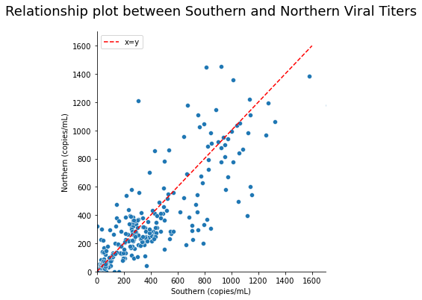
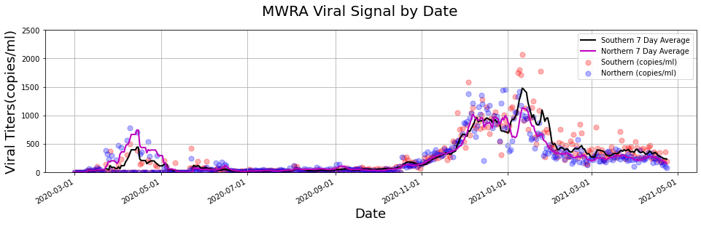
Exploratory Data Analysis
TAKE AWAY
Strong relationship between Southern and Northern titer data
Over the time Southern and Northern titer data has strong correlation

Slide 9
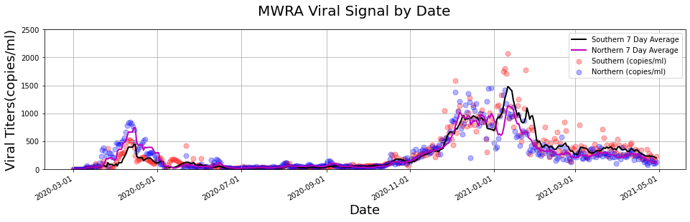
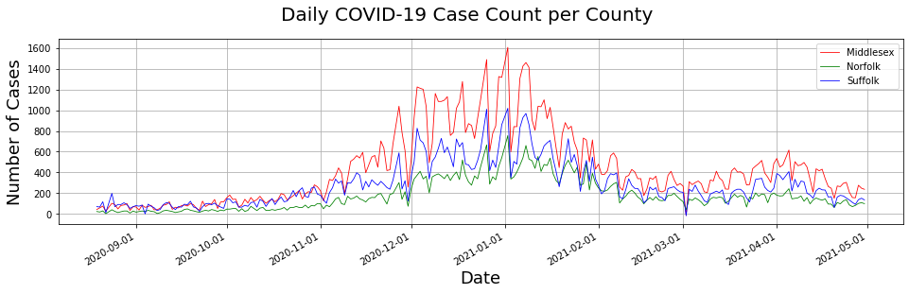
Exploratory Data Analysis
TAKE AWAY
Point 1

Slide 10
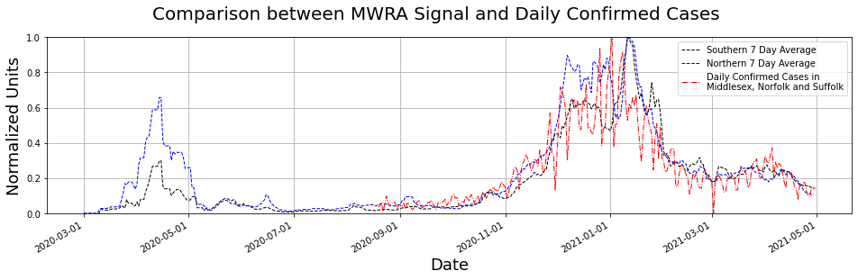
Exploratory Data Analysis
TAKE AWAY
Point 1
Point 2

Slide 11
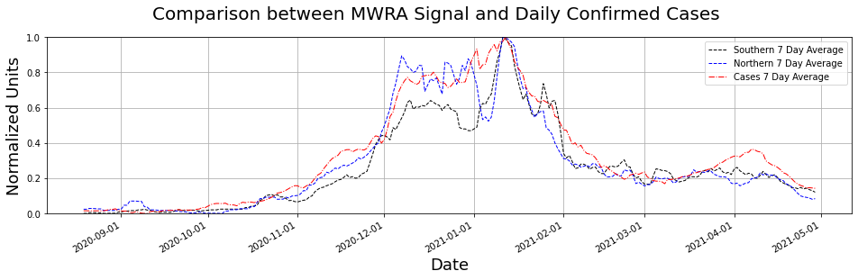
Exploratory Data Analysis
TAKE AWAY
Point 1
Point 2

Slide 12
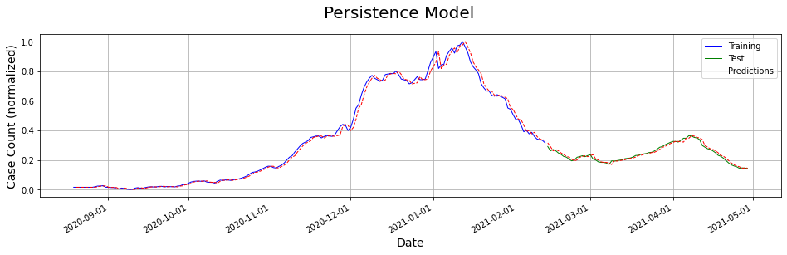
Models Explored
TAKE AWAY
Point 1
Point 2

Slide 13
Models Explored
Slide for Multi Linear Regression
TAKE AWAY
Point 1
Point 2

Slide 14
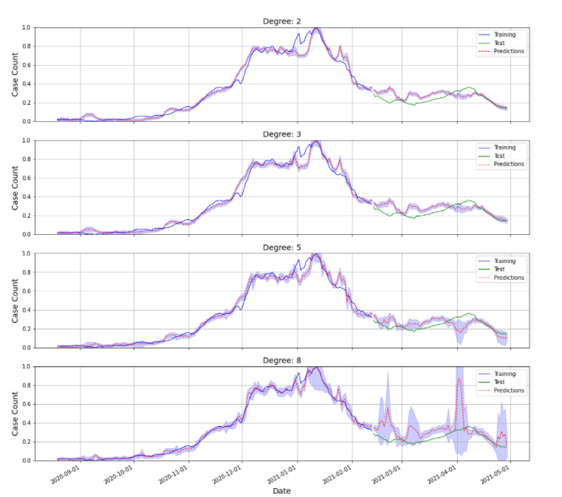
Models Explored
Slide for Polynomial Regression
TAKE AWAY
Point 1
Point 2

Slide 15
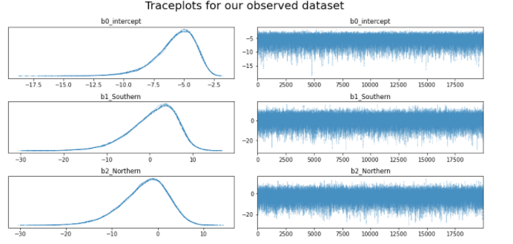
Models Explored
Slide for GLM Poisson
TAKE AWAY
Point 1
Point 2

Slide 16
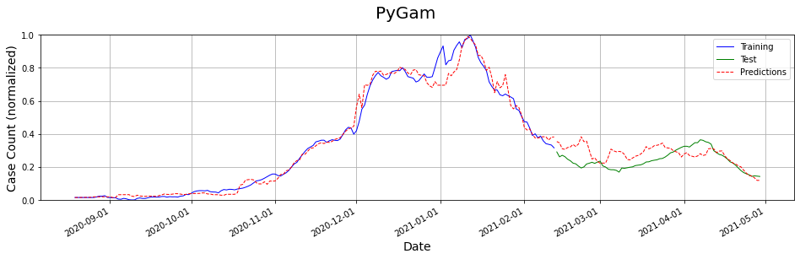
Models Explored
Slide for PyGAM
TAKE AWAY
Point 1
Point 2

Slide 17
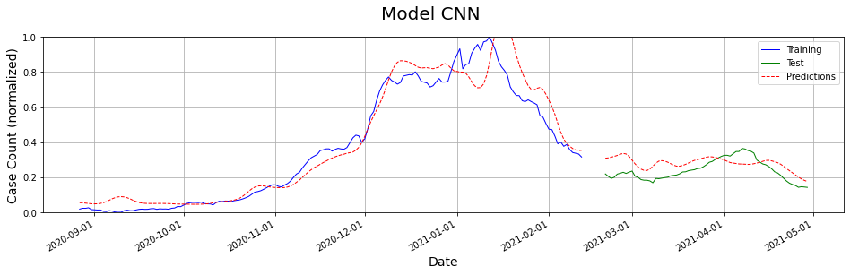
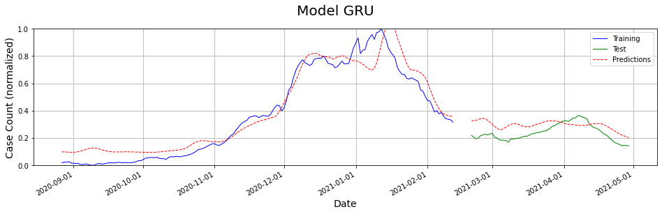
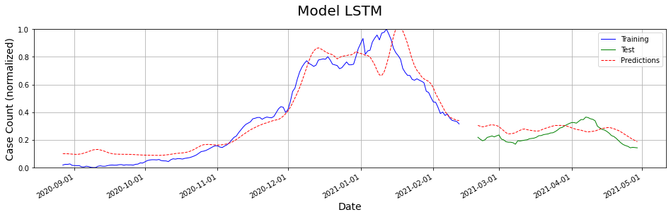
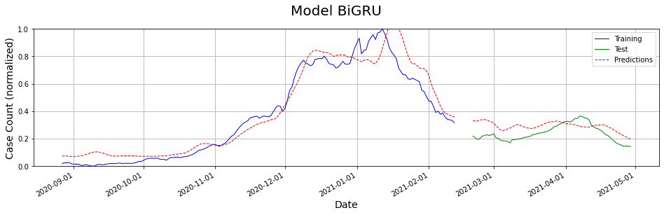
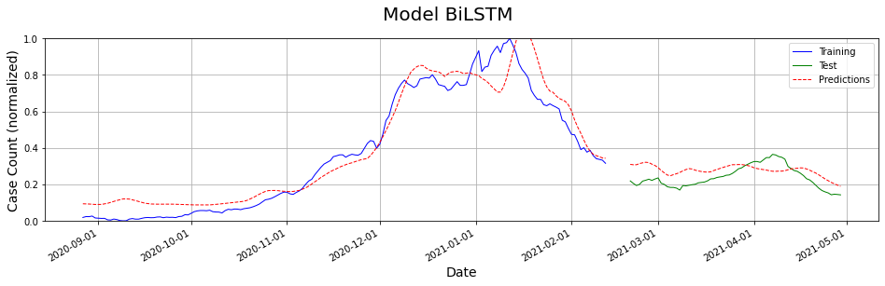
Models Explored
TAKE AWAY
Point 1
Point 2

Slide 18
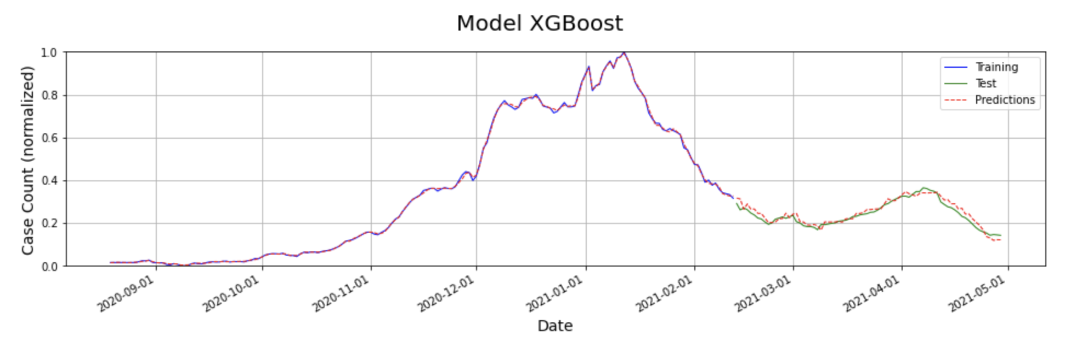
Models Explored
TAKE AWAY
Point 1
Point 2

Slide 19
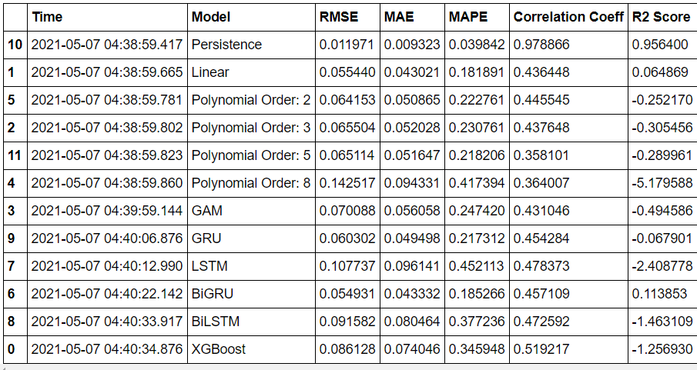
Models Explored

Slide 20
Conclusion & Next Steps
We did not have enough time for the following in case we had the time, we could have attempted the following
Travel pattern
Putting output of one model to the input of other

Slide 21
References and Special Thanks
Wu et al. SARS-CoV-2 titers in wastewater foreshadow dynamics and clinical presentation of new COVID-19 cases (2020 doi: https://doi.org/10.1101/2020.06.15.20117747)
https://www.mwra.com/biobot/biobotdata.htm
https://www.mass.gov/info-details/covid-19-response-reporting#covid-19-interactive-data-dashboard-
Yang et al. Accurate estimation of influenza epidemics using Google search data via ARGO (2015, https://doi.org/10.1073/pnas.1515373112)
Special Thanks
We would like to say special thanks to the following
Dr. Mauricio Santillana,
TF of the 109b – Prof Protopapas, Glickman, Tanner
Teaching Assistants

Slide 22
THANK YOU

